Slide 1
Section 5.1
Integration: “An Overview of the Area Problem”

Slide 2
All graphics are attributed to:
Calculus,10/E by Howard Anton, Irl Bivens, and Stephen Davis Copyright © 2009 by John Wiley & Sons, Inc. All rights reserved.

Slide 3
Chapter Overview
In this chapter we will begin with the idea of what “area” means and we will study two approaches to defining and calculating areas.
After that, we will discuss the Fundamental Theorem of Calculus and how it relates tangent lines and areas.
Later, we will study more rectilinear motion (position, velocity, acceleration along an s-axis) and integrals involving logarithms.

Slide 4
The Area Problem
Formulas for the areas of polygons, such as squares, rectangles, triangles, and trapezoids, were well known in many early civilizations.
However, the problem of finding formulas for regions with curved (curvilinear) boundaries caused difficulties for early mathematicians.
The bottom of page 316 and the top of page 317 describes some work for the area formula of a circle involving different mathematicians and limits that you might find interesting, as well as a brief biography of Archimedes on page 318.

Slide 5
The Rectangle Method for Finding Area
Divide the interval [a,b] into n equal subintervals and construct a rectangle on each subinterval from the x-axis to the curve f(x).
Find the area of each rectangle.
Find the sum of the areas of all of the rectangles in the interval [a,b].
This total will be an approximation to the exact area under the curve over the interval [a,b].
The more rectangles you divide the interval [a,b] into, the more accurate your approximation will be compared to the exact area.
The limit as the number of rectangles, n, approaches infinity equals the exact area under the curve on [a,b].

Slide 6
Visual representation of how much closer the approximation gets as the number of rectangles in the interval increases.

Slide 7
The Antiderivative Method for Finding Area
When we use the rectangle method, we often end up with limits that we do not know how to compute or limits that are very long and difficult to compute.
Therefore, the antiderivative method was discovered to make those problems possible.
The derivative of the area equals the original function:
A’ = f(x)

Slide 8
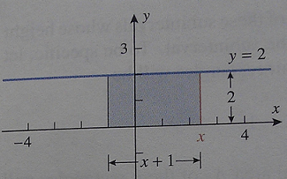
Confirming A’ = f(x) Using Geometry Examples
Example 1: Find the area A(x) between the graph of f(x)=2 and the interval [-1,x] and find the derivative A’(x) of this area function.
As you can see from looking at the graph, the area is a rectangle and we can find the area A(x) = base * height.
A(x) = (x-(-1))(2) = (x+1)*2 = 2x + 2
The derivative of the area function above A(x) = 2x + 2 is A’(x) = 2 which is equal to the original function.
Therefore, A’(x) = f(x).

Slide 9
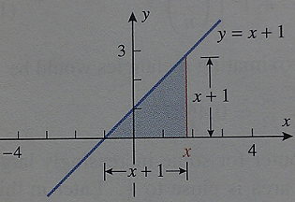
Confirming A’ = f(x) Using Geometry Examples
Example 1: Find the area A(x) between the graph of f(x)=x+1 and the interval [-1,x] and find the derivative A’(x) of this area function.
As you can see from looking at the graph, the area is a triangle and area A(x)=(1/2)base*height.
A(x)=(1/2)(x-(-1))(x+1)=(1/2)(x+1)(x+1)
=(1/2) x² + x + 1/2
The derivative of the area function above is
A’(x) = x+1 which is equal to the original f(x).
Therefore, A’(x) = f(x).

Slide 10
The Rectangle Method and the Antiderivative Method Compared
NOTE: There is a third geometry example on page 320 with a different line, and the antiderivative method works for higher degree polynomial functions and more sophisticated functions.
The rectangle method and the antiderivative method are very different approaches to solving the same problem of finding area.
The antiderivative method is usually quicker and more efficient.
The rectangle method makes more sense intuitively and we will use a similar method to find volume, length of a curve, surface area, etc.

Slide 11
Vacation!!

